Slide 1
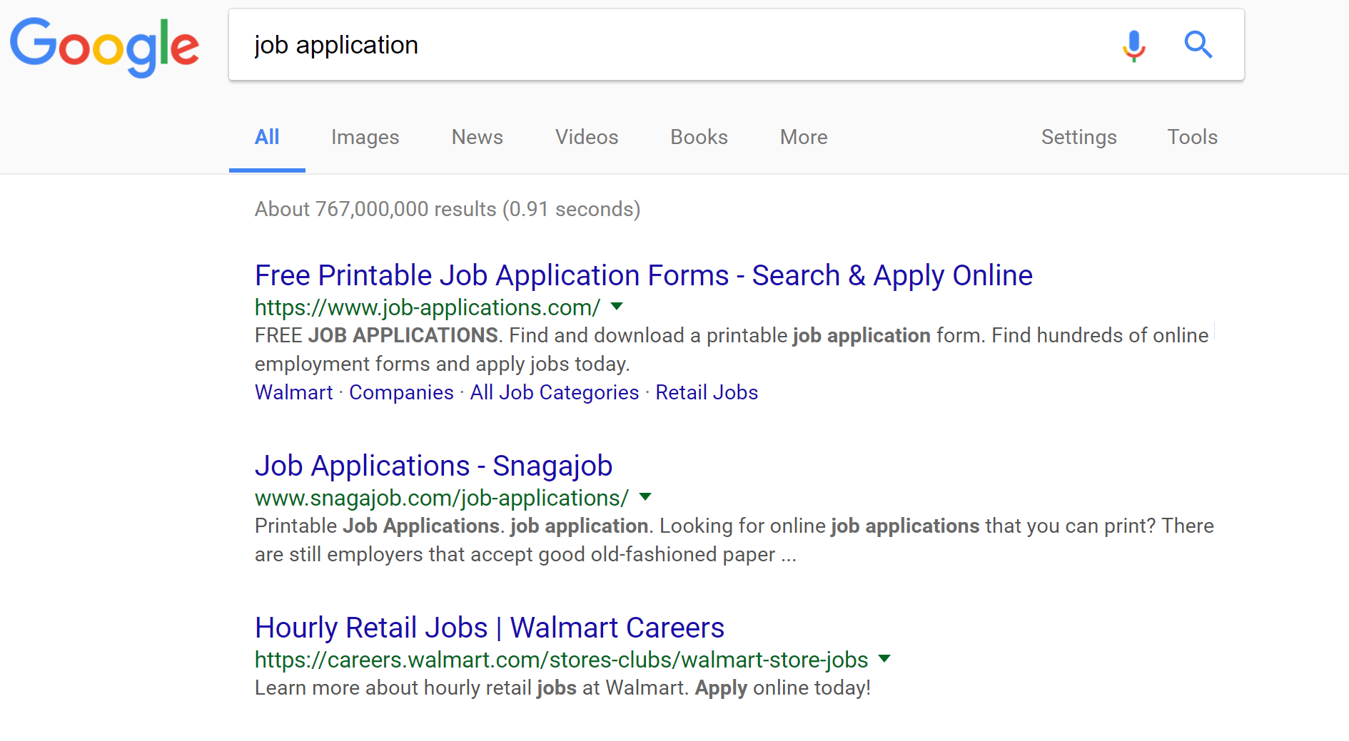



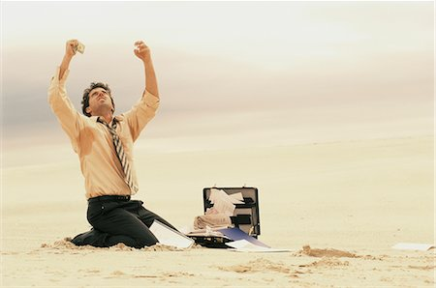
Little Bird Told Me
Data Dream Team:
Matt Kaiser--David Perisco--Troy Kayne--Amir Kashipazha

Slide 2
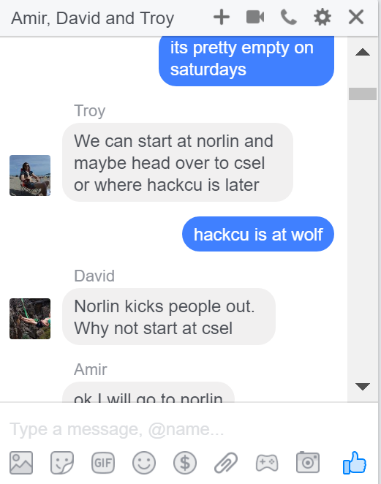


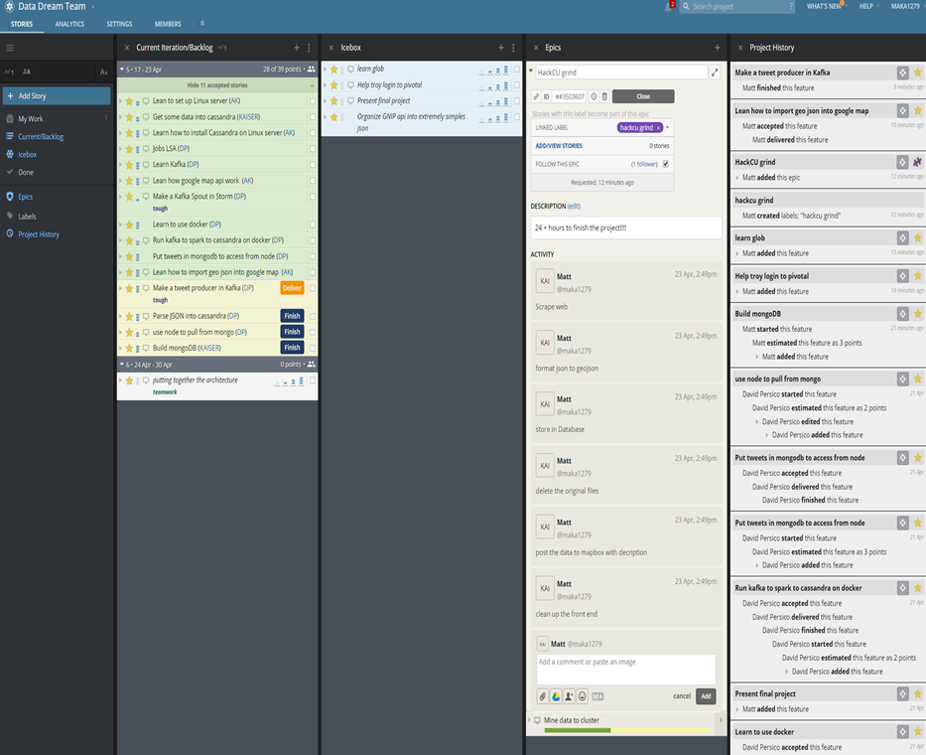
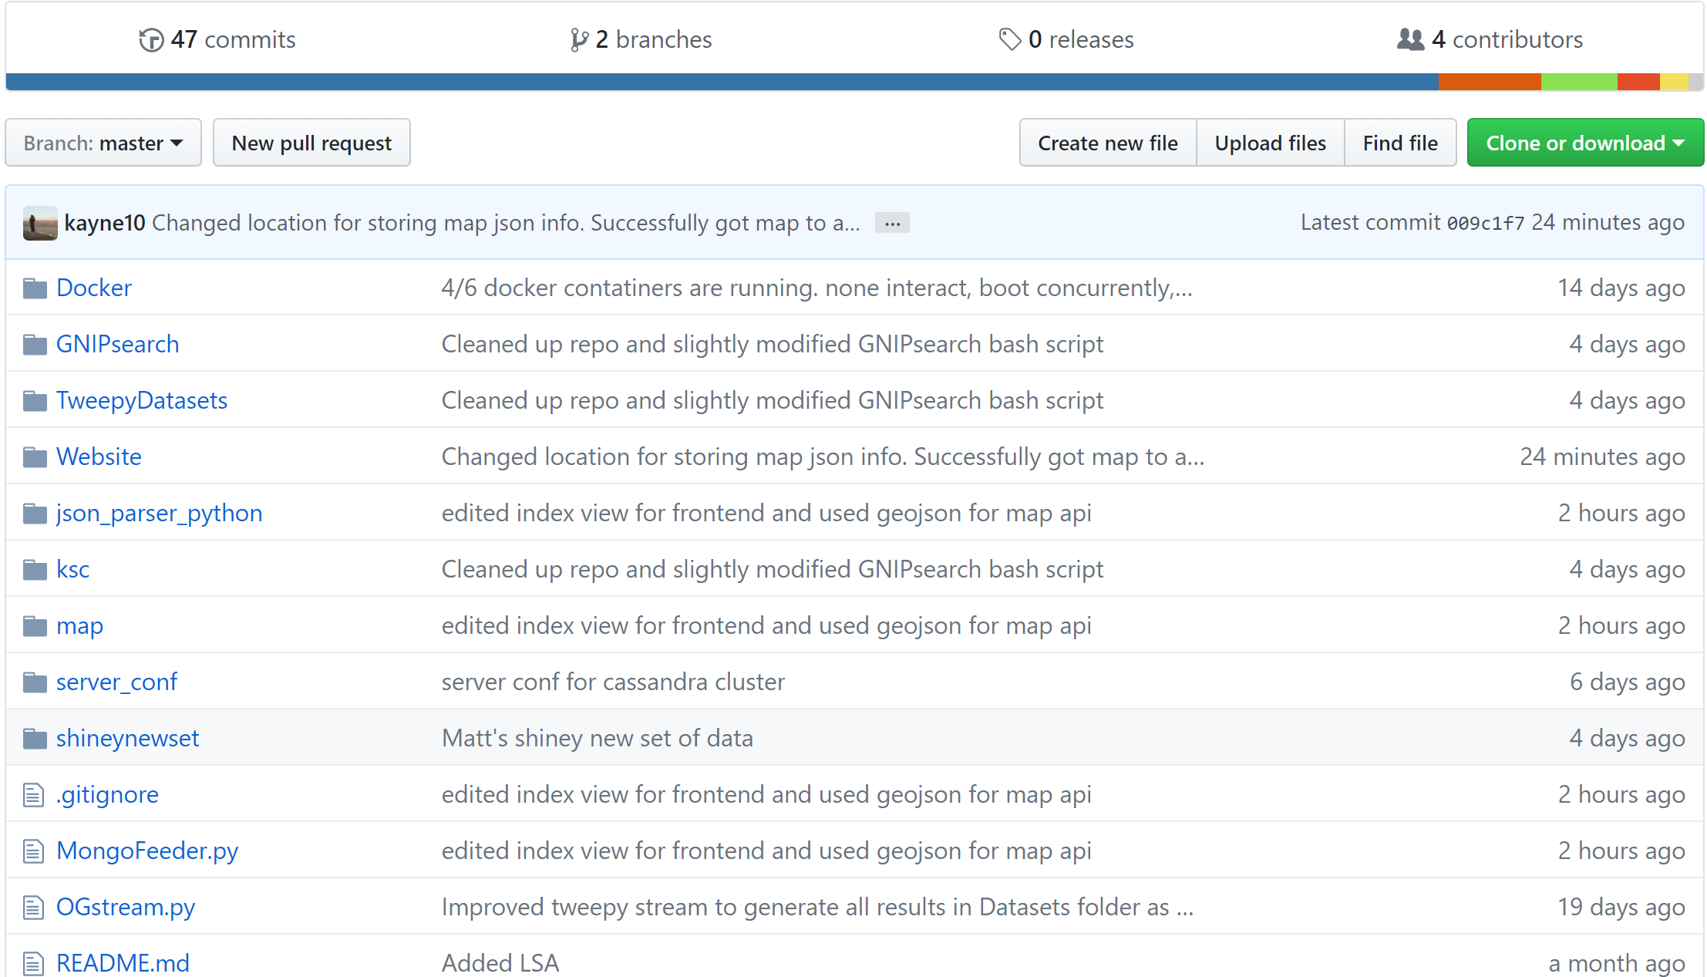
Communication/ Work Tracking

Slide 3















Slide 4

☺ Demo!!!!!!!!!!!!!!!!!!!!!!!!!!!! ☺

